Slide 1
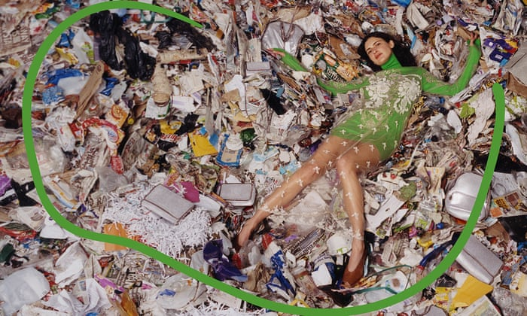
CSE 3330 Spring 2020 Project 2: Online Return induced Trash [1]
Notes:
https://www.theguardian.com/fashion/2017/jul/29/fashion-must-fight-scourge-dumped-clothing-landfill
Stella McCartney’s winter 2017 collection was modelled against the backdrop of a landfill site. Photograph: Harley Weir and Urs Fischer for Stella McCartney

Slide 2


A study indicated that offering free online returns would drive customers to spend more
Retailers didn’t realize that implementing this research’s recommendations leads to more items being returned as well
If it's cheaper for the retailer to throw out returned goods rather than try to resell them, they end up in the trash – CNN Money [5]
Notes:
https://money.cnn.com/2017/12/26/news/retail-returns-landfill/index.html

Slide 3
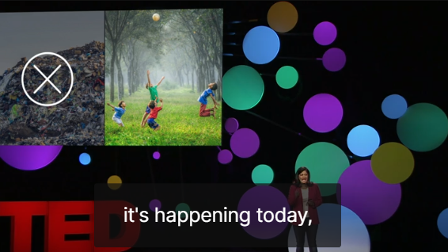
Aparna Mehta TED@UPS [2] Global Solution director for top-tier retail
Where do your online returns go?
Notes:
https://www.ted.com/talks/aparna_mehta_where_do_your_online_returns_go/transcript?language=en#t-417543

Slide 4
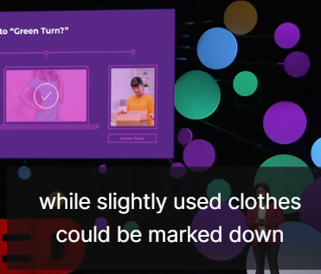
Aparna Mehta TED@UPS [2] Global Solution director for top-tier retail
Online orders -> over ordering
Free shipping, free returns
Retailers’ biggest concern: Managing returns
One client-1 holiday season – 7.5 Mil clothing returned
4 billion pound of returned clothing go to landfills
In US, companies lost $351 billion in sales in 2017 alone
Green Return
use app to take a picture – verify condition – return item
AI systems to sort
from one buyer to the next
incentives – loyalty points or cash back
5 fewer items returned/adult-> 245 M lbs less clothing in the landfill
Notes:
https://www.ted.com/talks/aparna_mehta_where_do_your_online_returns_go/transcript?language=en#t-417543

Slide 5
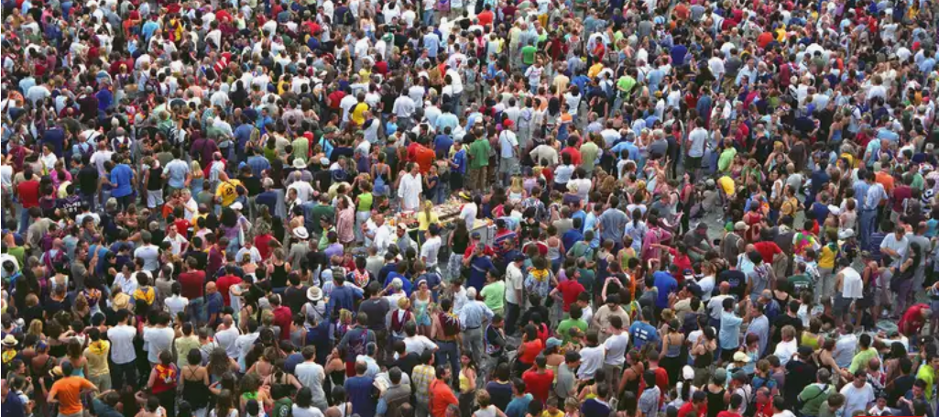
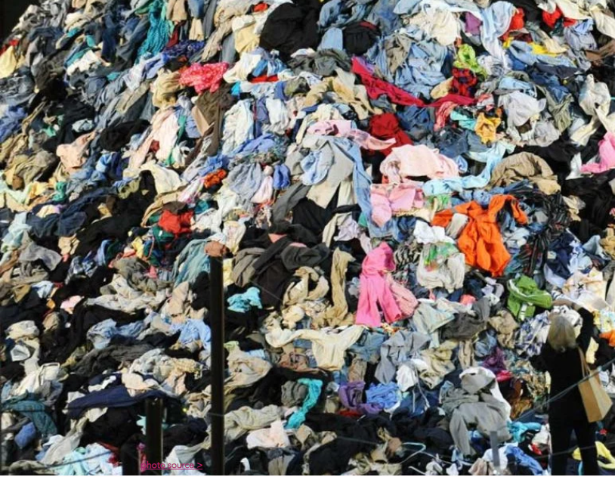
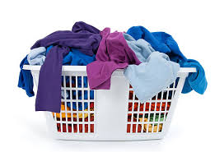
Aparna Mehta’s TED Talk: Four billion pounds of returned clothing ends up in the landfill -as if every resident in the US did a load of laundry last night and trashed it. US population – 330 Million [3] Average laundry weight – 12 lbs
Notes:
https://www.thoughtco.com/us-population-through-history-1435268 330 million population
Clothes landfill image https://www.mizuchiswimwear.com/fashion-affects-us

Slide 6

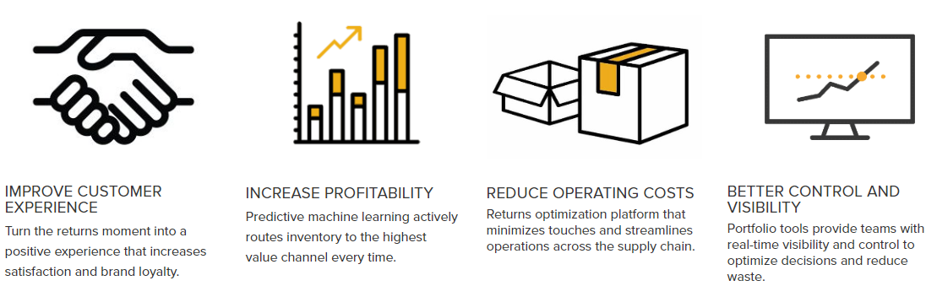
Optoro [4]
Optoro[4] is a company that helps companies manage online returns to reduce/eliminate trash resulting from online returns

Slide 7

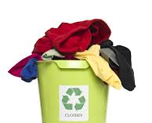
Student Project 2: Designed, developed, executed by students, and graded by their peers
This project:
Will be about implementing a database solution for a company that in some way alleviates the problems caused by online apparel returns
Will be done by groups of 5 students each
Will be unique for each student group
Will have 3 phases:
Domain selection and presentation. Students will present themselves as a group of social entrepreneurs who have selected a domain from Multi Billion Ton returned apparel-based trash problem. They can choose any small domain where they will run a profitable business while improving the returned-apparel based trash situation.
Requirements selection for the database that the company needs to have to conduct its business. Create a conceptual schema database design using the ER/EER model, then convert it to a relational (tabular) schema using the rules for ER/EER-to-relational (tabular) mapping .
Data creation and populating the relational database, write queries in SQL, and have at least 1 view. Program a web interface to enter query parameters and display query results to solve their business needs

Slide 8
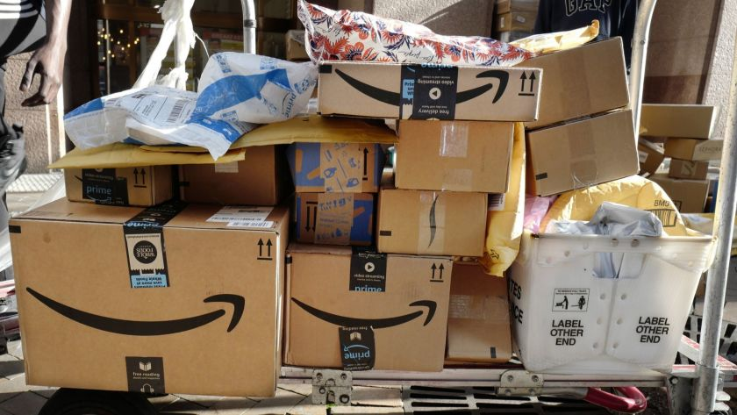
Phase 1: Mini Domain selection
Mini Domain selection and presentation.
Research ideas to capture potential domains
Select a domain
Present choice based on facts, supported by numbers from credible sources
Include services offered/or work done by your company
What is the impact of your company on returned apparel/related trash?
Photo credit: Los Angeles Times https://www.latimes.com/business/story/2019-11-13/amazon-returns-are-killing-the-environment
Notes:
Source: https://www.bloomberg.com/news/features/2019-07-11/how-the-world-can-solve-its-2-billion-ton-trash-problem

Slide 9
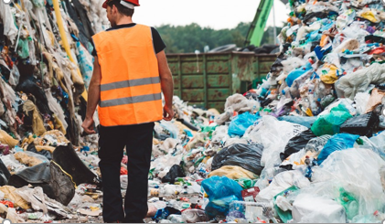
Phase 2: Requirements, EER, Schema
Write requirements for company database
Describe entities, relationships, special requirements.
Create a conceptual schema database design using the ER/EER model
Convert it to a relational (tabular) schema using the rules for ER/EER-to-relational (tabular) mapping
Present your work
Photo credit: https://www.bbcearth.com/blog/%3Farticle%3Dyour-brand-new-returns-end-up-in-landfill/
Notes:
Source: https://www.bloomberg.com/news/features/2019-07-11/how-the-world-can-solve-its-2-billion-ton-trash-problem

Slide 10
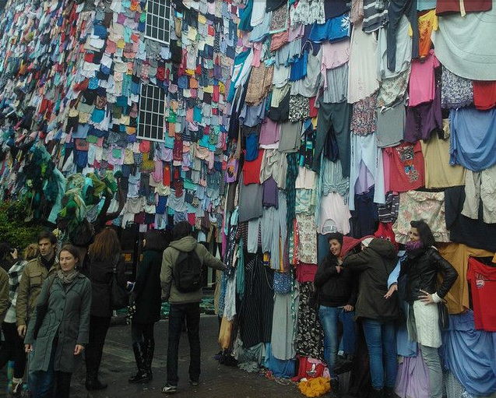
Phase 3: Create data, queries, views, web interface, consume data files
Create and load data into the relational database,
Write queries in SQL
Have at least one view.
Program a web interface to enter query parameters and display query results to solve their business needs
Generate/consume data files for/from other projects
Present how your database and interface fulfill your business needs
Present how your company alleviates the returned-apparel based trash problem
Photo credit: https://www.treehugger.com/corporate-responsibility/marks-spencer-shwopping-camapign.html

Slide 11

Some Ideas
https://www.theguardian.com/fashion/2017/dec/06/landfill-becomes-the-latest-fashion-victim-in-australias-throwaway-clothes-culture
https://www.theguardian.com/fashion/2017/jul/29/fashion-must-fight-scourge-dumped-clothing-landfill
https://www.bbc.com/news/world-44968561
https://pixelpool.com/hm-and-their-billion-dollar-apparel-mountain/
https://www.bloomberg.com/opinion/articles/2019-11-13/those-amazon-returns-they-re-killing-the-environment
https://money.cnn.com/2017/12/26/news/retail-returns-landfill/index.html
https://edelivery.net/2019/12/ikea-implements-returns-management-tech-streamline-circular-business-model/
https://www.optoro.com/
https://www.bbc.com/news/business-44885983
https://www.treehugger.com/corporate-responsibility/marks-spencer-shwopping-camapign.html
https://theoutline.com/post/2602/clothing-companies-are-trashing-unsold-merchandise-instead-of-donating-it?zd=1&zi=qexjdsqg
https://www.bbc.com/news/business-44885983
https://theoutline.com/post/2602/clothing-companies-are-trashing-unsold-merchandise-instead-of-donating-it?zd=2&zi=qexjdsqg

Slide 12


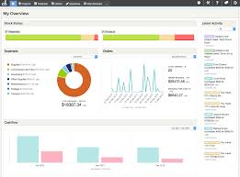
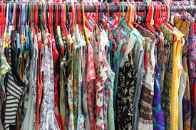
Track, Count, Remind, Resell
Some ideas for possible projects
https://pixelpool.com/hm-and-their-billion-dollar-apparel-mountain/
When H&M shared their latest quarterly report, they recorded a decline in operating profit of 61% in the three months through February. Making their shares plummet to the lowest closing price since 2005. This, however, was not the biggest surprise in the quarterly report. H&M reported a gigantic pile of unsold clothing, with a value of 3.7 billion euro’s.
Notes:
A garbage truck of trash entering the oceans every minute – but Oceans are the last thing we need to clean. Countless birds dying from encountering plastic
If water is overflowing in your kitchen, it is pointless to clean/mop kitchen.
80% of the ocean plastic is coming from poor country.
Everything in the store can be bought using plastic garbage – school tuition, medical insurance, wifi, cell phone minutes, cooking fuel
People develop a steady, reliable source of income Plastic Bank sorts the plastic, labels them, shred it or get ready in bales for exports
Many companies like Marks and Spencer have commissioned the use of Social plastic
Remove plastic from ocean and alleviate poverty at the same time

Slide 13
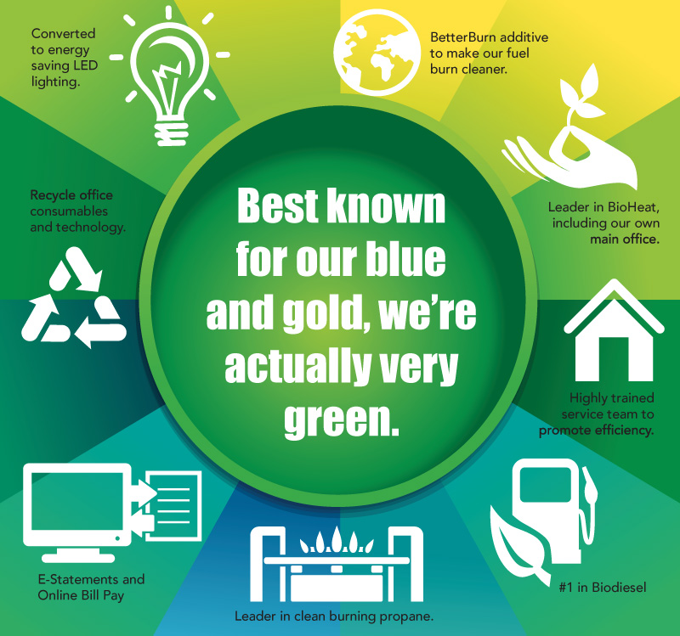
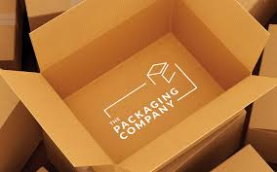

Holiday returns in landfill
Some ideas for possible projects
https://money.cnn.com/2017/12/26/news/retail-returns-landfill/index.html
Each year, consumers return about $380 billion worth of goods -- $90 billion of which are processed during the holiday, according to Optoro.
Not only are these returns environmentally unfriendly, but they are costing retailers a fortune.
Only half of returns make it back onto shelves, the company estimates. The rest, due to circumstances such as damages or opened boxes, take a different path.
About a quarter of items are returned to the manufacturer. Others go to secondary retailers.
Notes:
Take the linear economy – and join the two ends by using the waste as a raw material
Decomposition of food
And Combustion of fossil fuel that also generates green house gases
Put these together in one closed loop economy
Natural gas is mostly methane
Take methane from the top process and use as a resource in the bottom process

Slide 14
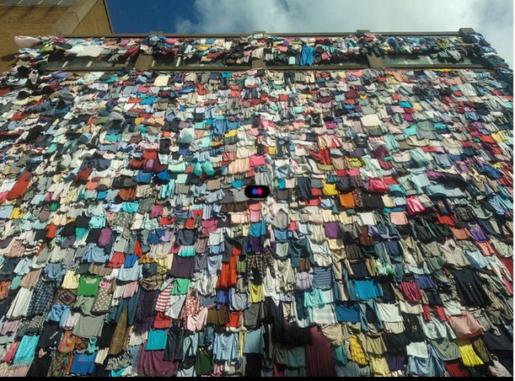
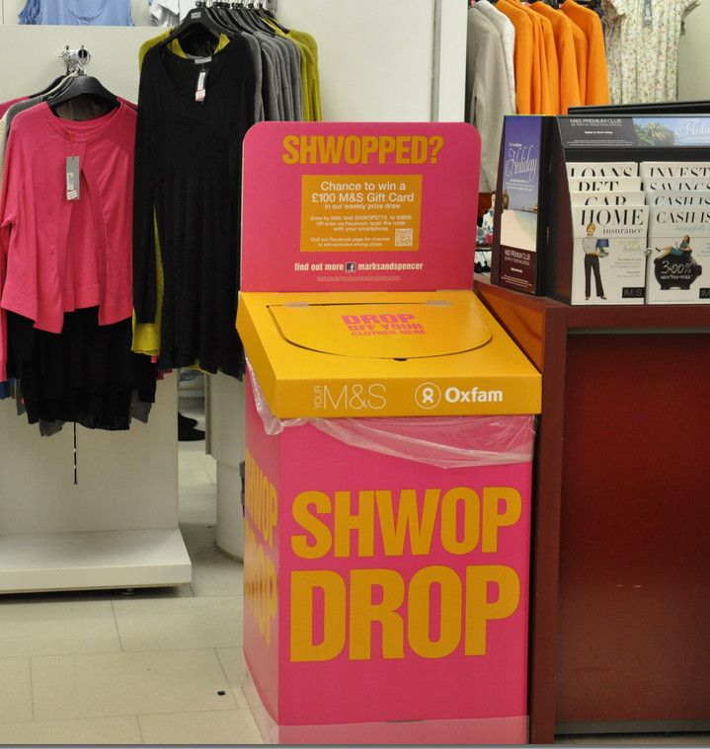
Schwopping
Some ideas for possible projects
• Resell clothes – in shops, online, at festivals or through overseas enterprises, like Frip Ethique in Senegal. • Reuse clothes – garments that can’t be worn again are sold to designers who restyle them for use in new collections. • Recycle clothes – even if they don’t make the grade, old clothes are never sent to landfill. Instead, they’re sold in bulk to reprocessing companies where they could be reborn as mattress filling, carpet underlay or as a last resort, incinerated. Some of the garments will even be turned in to new fibres for use in new garments.
Notes:
https://theoutline.com/post/2602/clothing-companies-are-trashing-unsold-merchandise-instead-of-donating-it?zd=2&zi=qexjdsqg

Slide 15

References
[1] https://www.theguardian.com/fashion/2017/jul/29/fashion-must-fight-scourge-dumped-clothing-landfill
[2] https://www.ted.com/talks/aparna_mehta_where_do_your_online_returns_go/transcript?language=en#t-417543
[3] https://www.thoughtco.com/us-population-through-history-1435268
[4] https://www.optoro.com/
[5] https://money.cnn.com/2017/12/26/news/retail-returns-landfill/index.html

